Slide 1
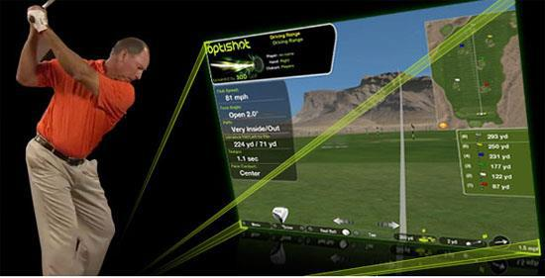

Powered by
Corporate Pricing for Golf Simulator

Slide 2
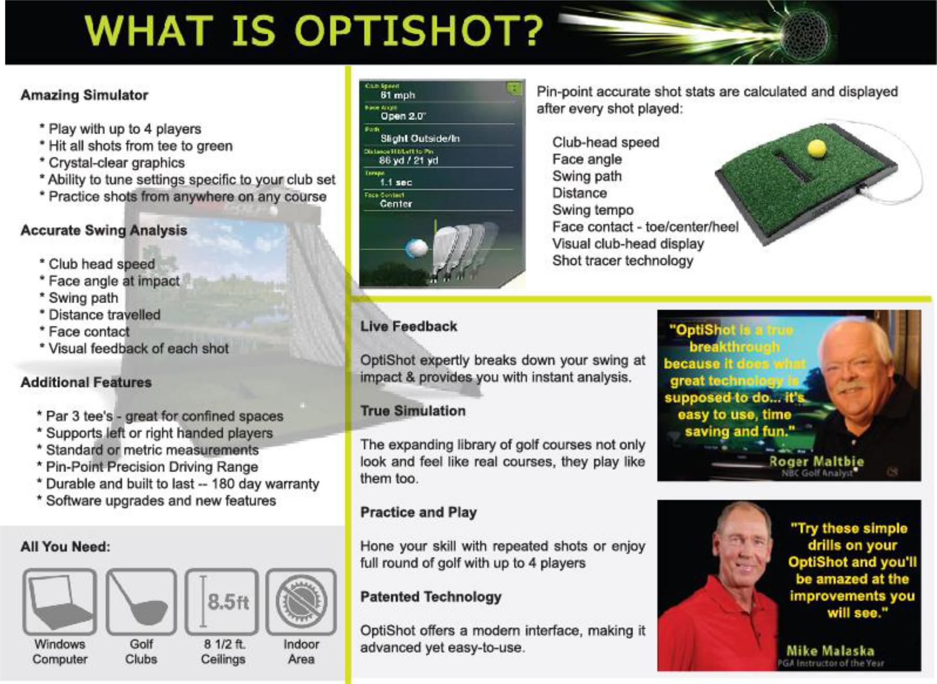

Slide 3
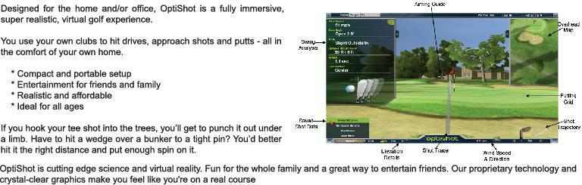
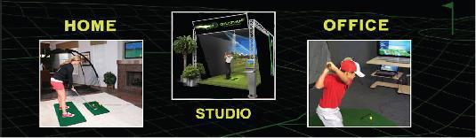

Slide 4
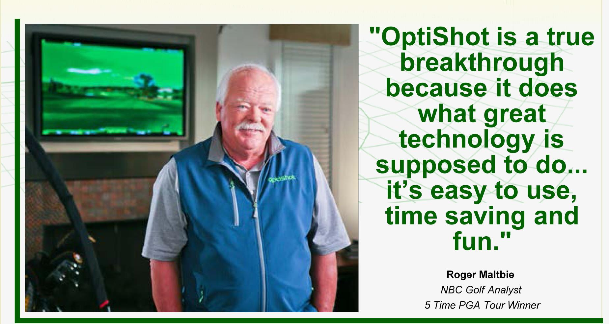

Slide 5
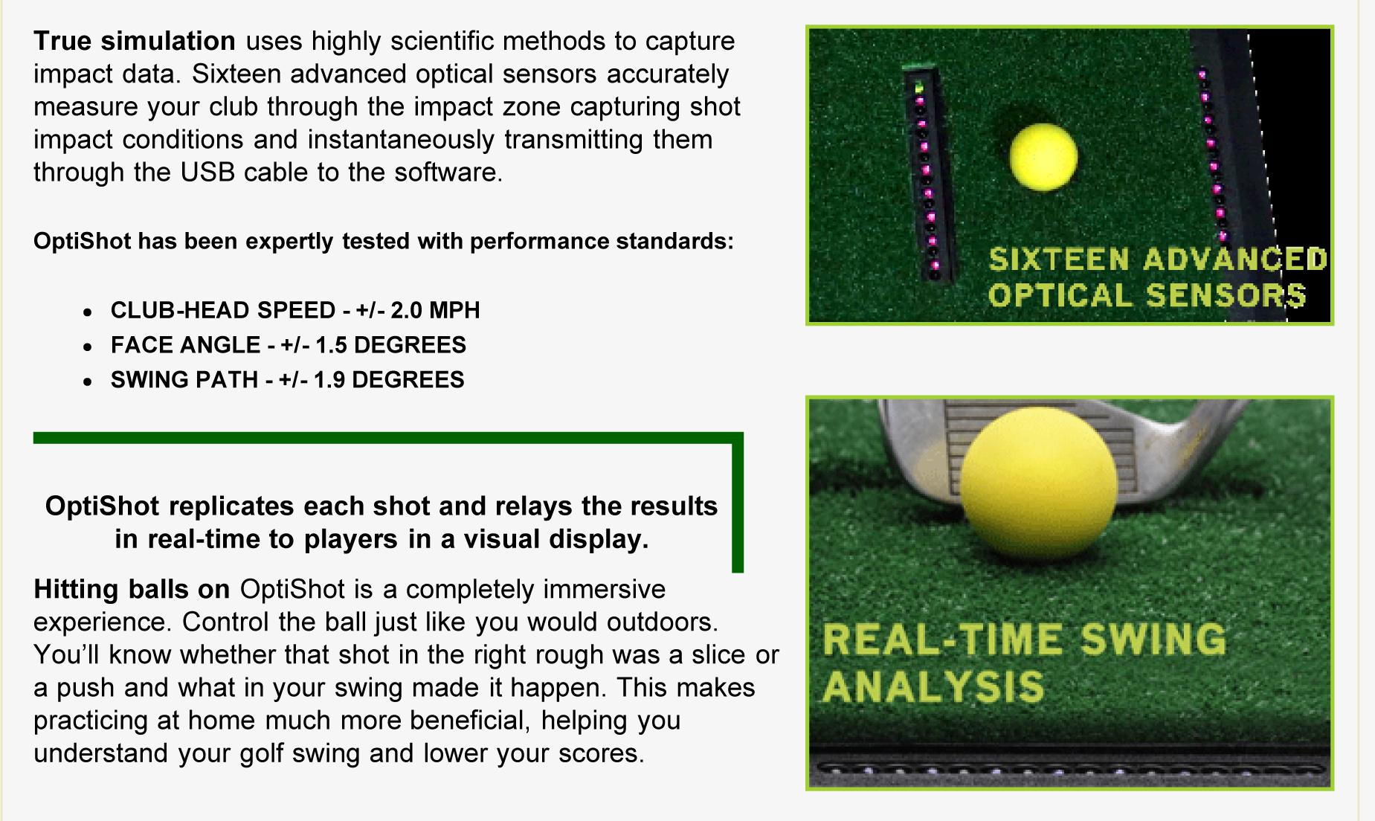

Slide 6
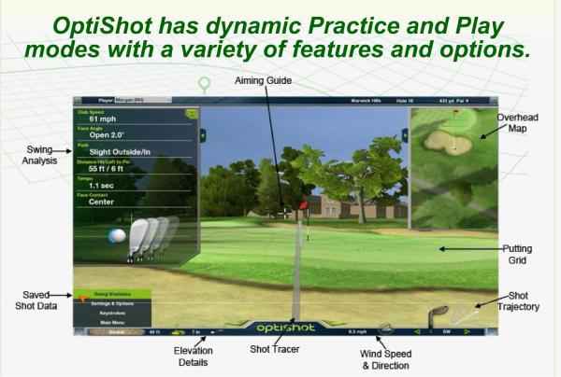

Slide 7
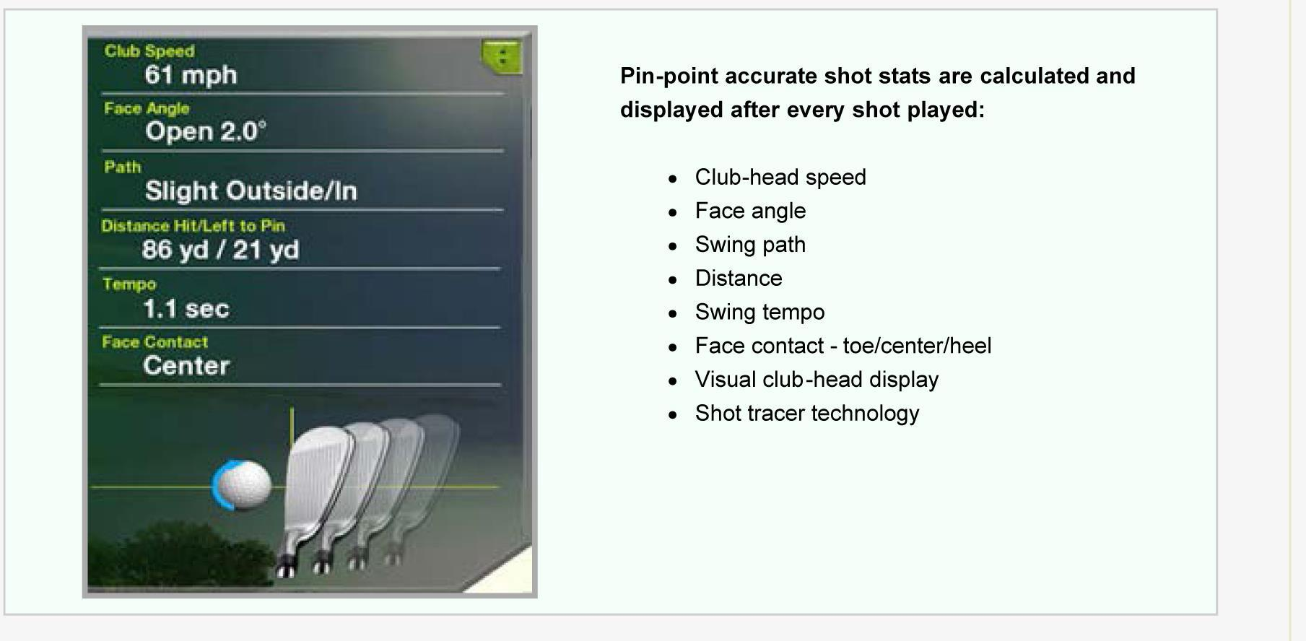

Slide 8
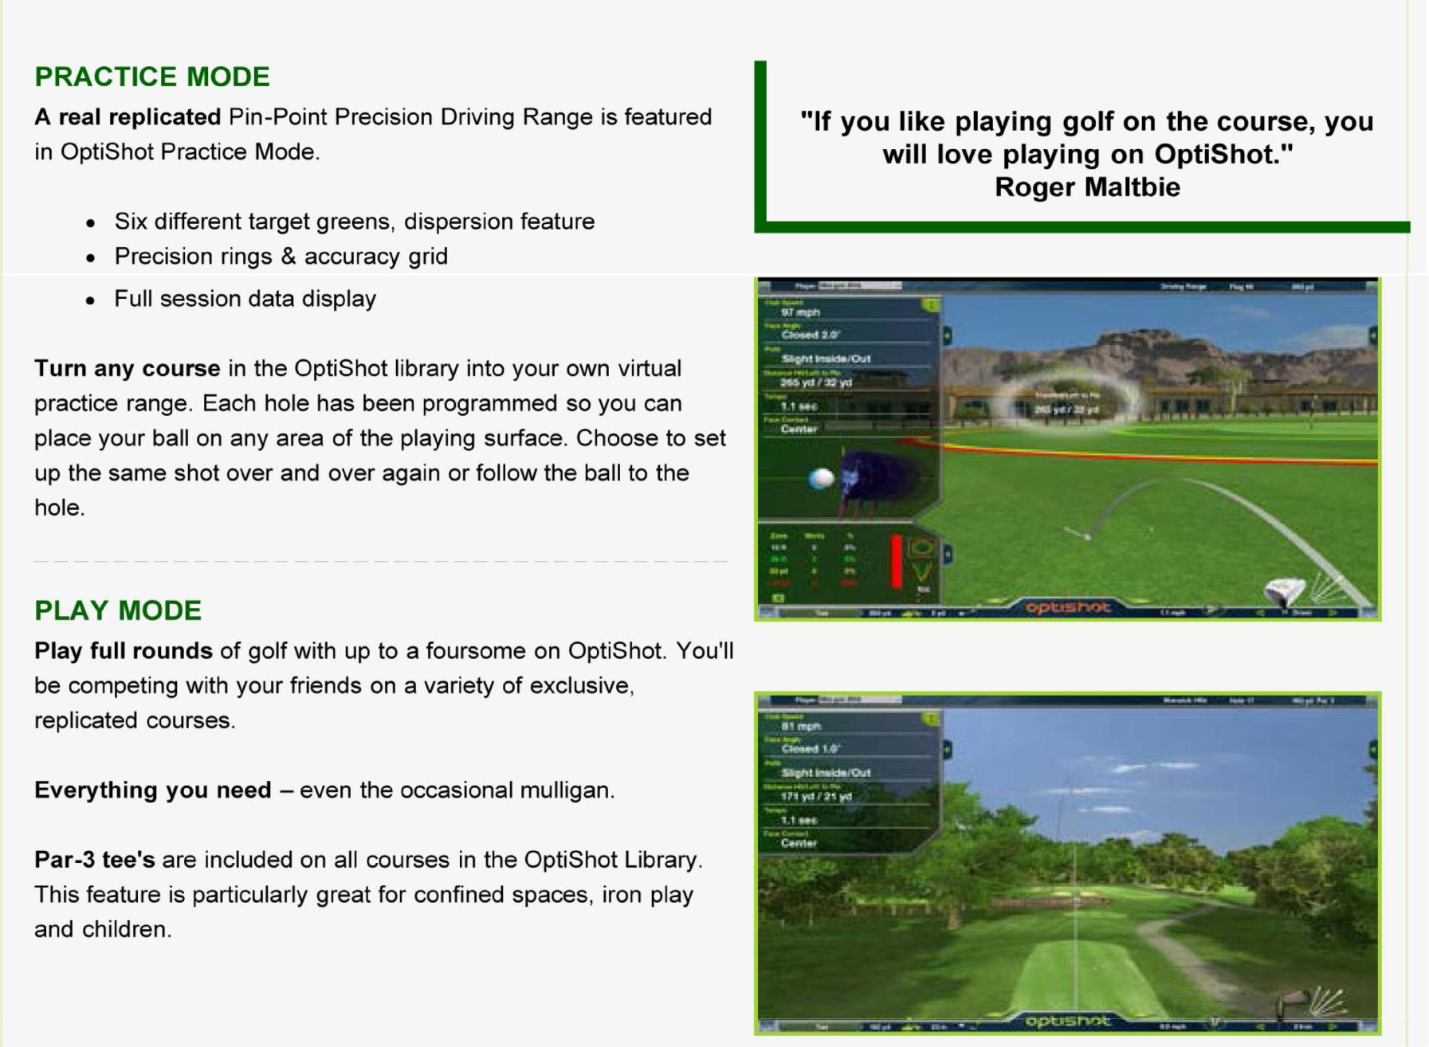

Slide 9
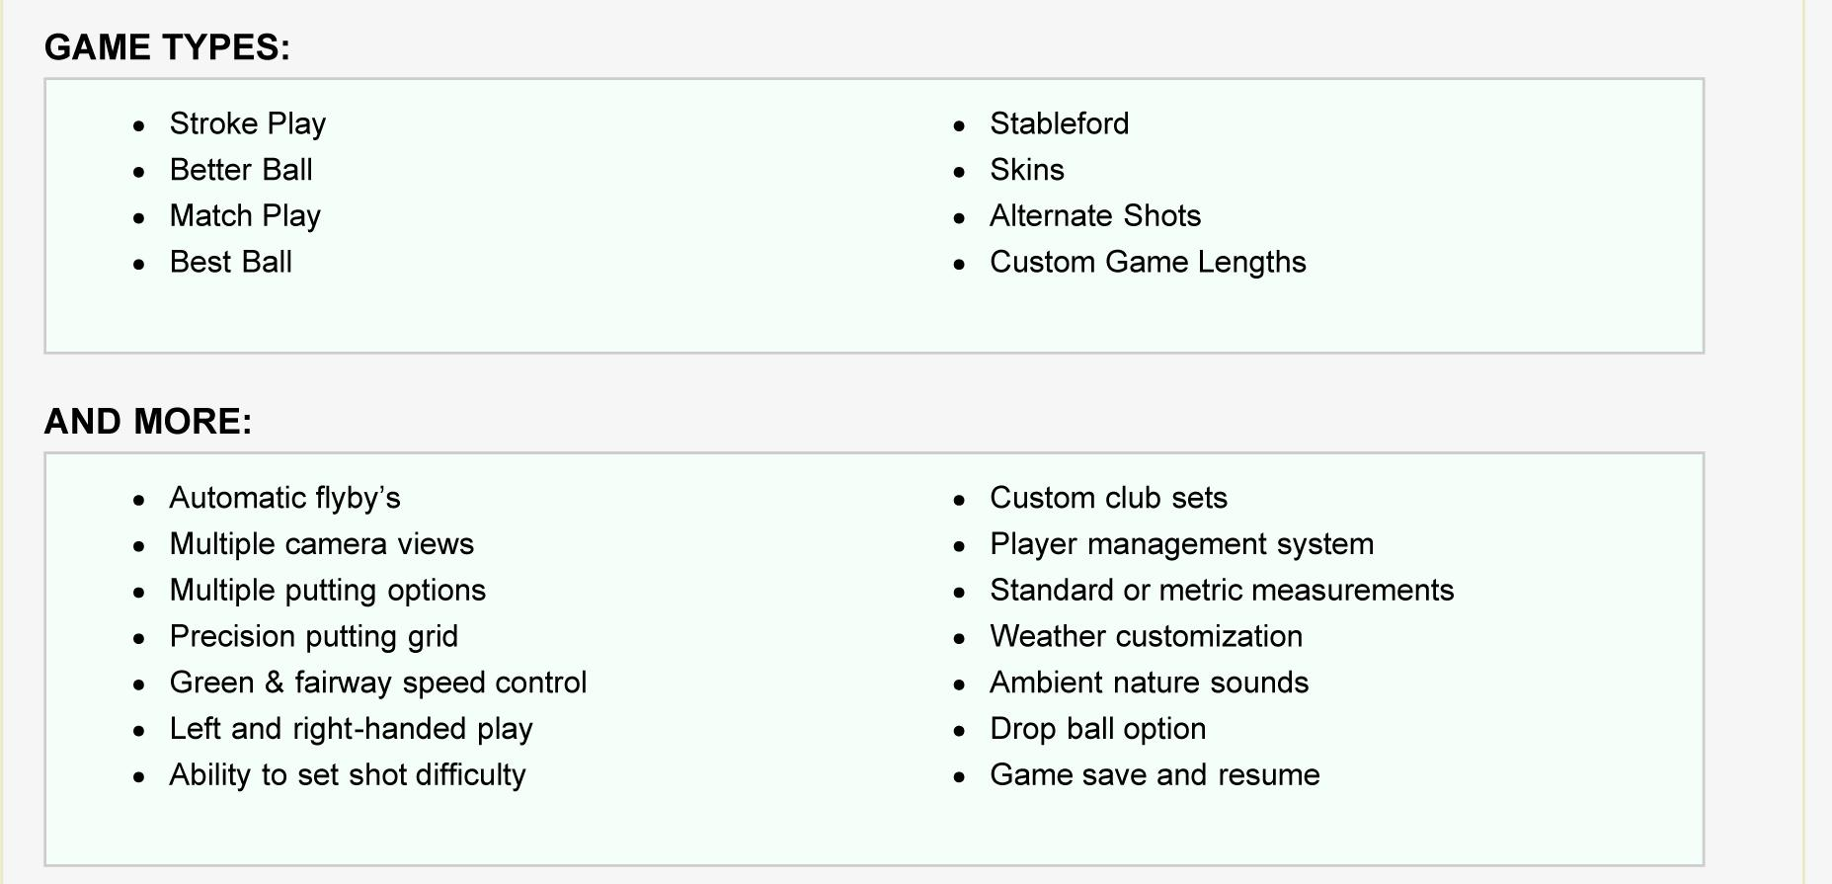

Slide 10

Testimony
“Now it turns out you don’t even need a golf ball to play a round of golf. With the OptiShot Golf Simulator, you don’t need a golf course, either, yet still play year-round
— in your living room, your office or your garage.”USA Today
“This new at-home simulator by OptiShot Golf means players can use their own clubs to take on their friends or test themselves on replicas of major championship venues and other world-famous courses.”CNN
“What OptiShot Golf is doing for golf is what Apple did for the personal computer. It has taken the dollar and performance mystique out of simulator technology and made it so affordable that practically anyone who plays golf can buy a set.”Asian Golf Monthly

Slide 11
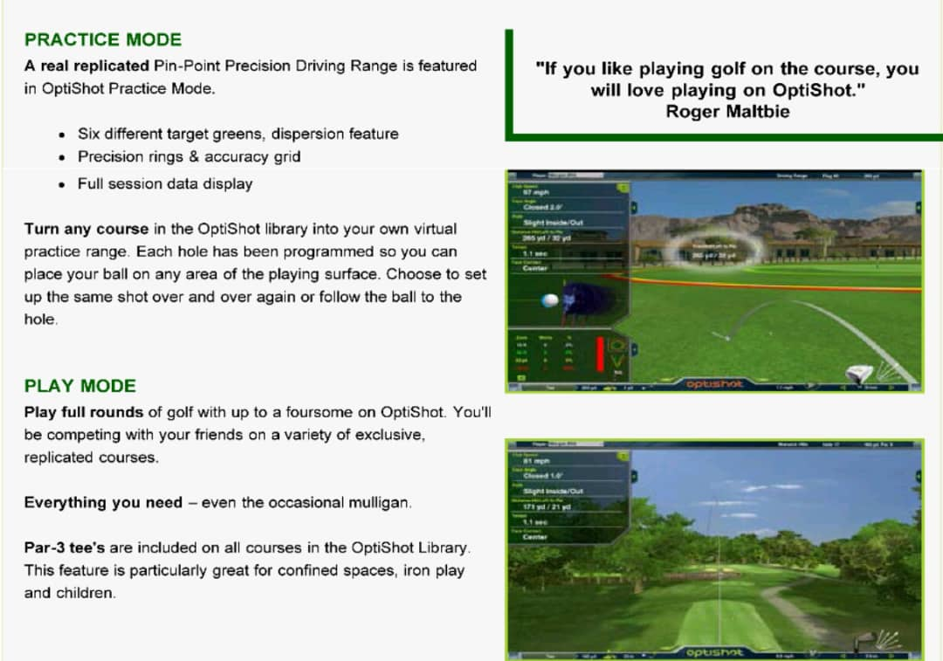

Slide 12
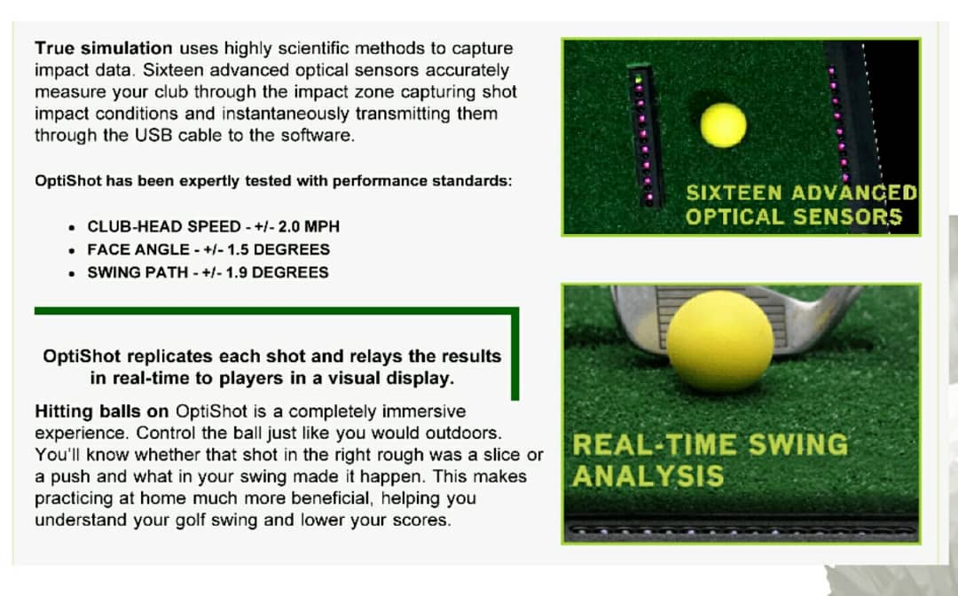

Slide 13
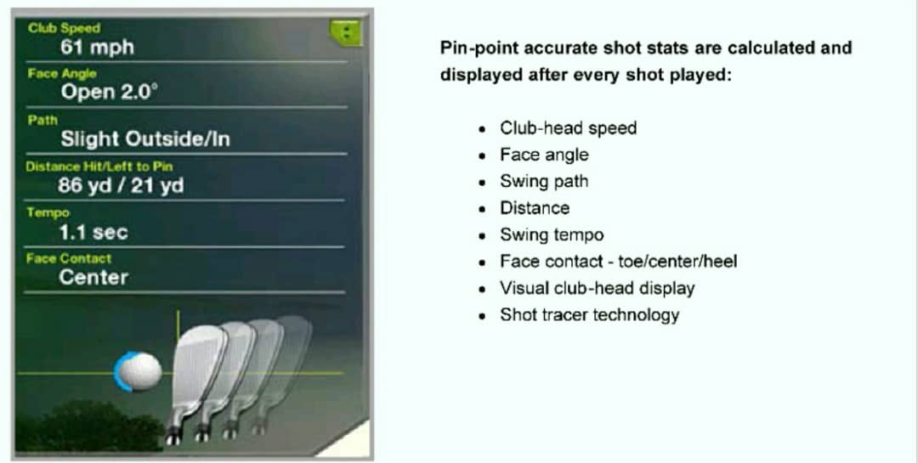

Slide 14




Testimony
“OptiShot Golf’s at-home simulator stands out in three ways: it’s fun, it’s useful
and it’s simple to use. All you need is a computer, your clubs and high
ceilings.”GOLF Magazine
“OptiShot Golf Simulator is a great in-home simulation alternative to the multi-thousand-dollar setups.”CBSSports.com
“OptiShot Golf Simulator can improve your swing with the added benefit of providing a fun version of indoor golf.”Golf Digest
“The OptiShot Golf Simulator offers simulated golf that you can play inside your house on some of the greatest golf courses in the world.”Golf Channel

Slide 15



Testimony
“The OptiShot Golf Simulator features a practice range and 12 courses. If a player wants to go and hit balls on the range all day long, they can; and if they get sick of that, they can pick out a course and go hit 130-yard shots from
anywhere.”Golfweek.com
“The OptiShot Golf Simulator has me halfwishing I had a house in the suburbs with a spacious rumpus room so I could hit the links all winter long.”Time

Slide 16
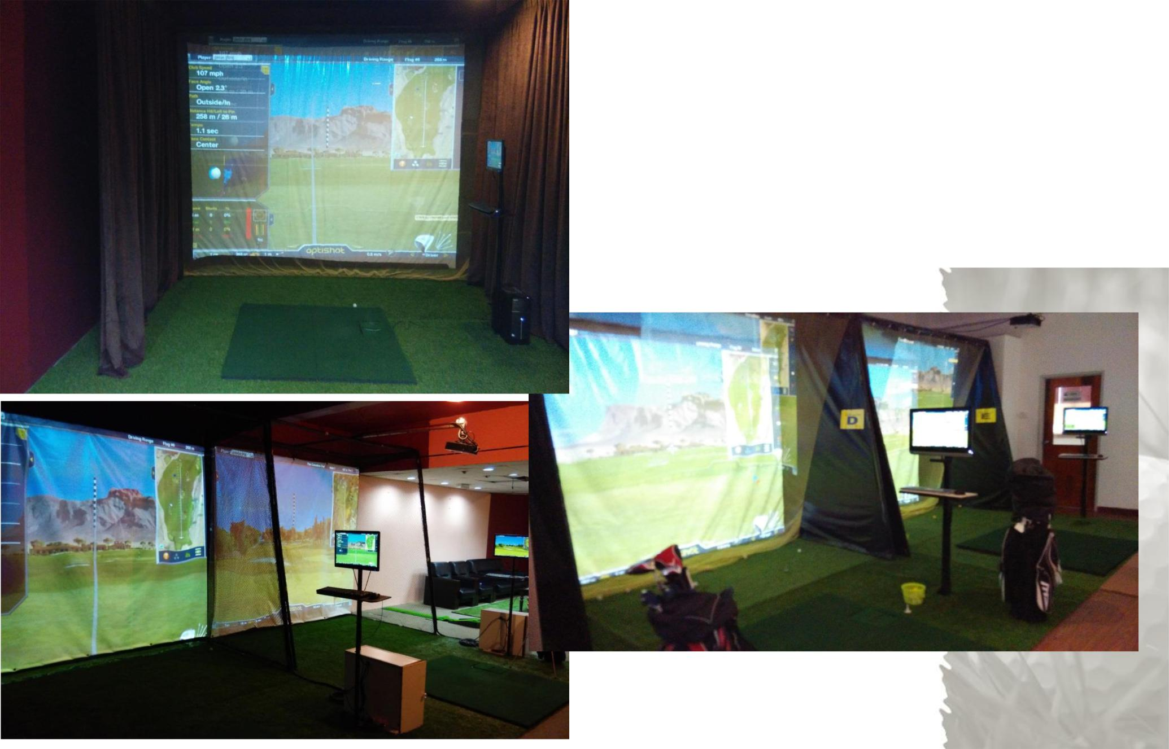
Golf Simulator

Slide 17
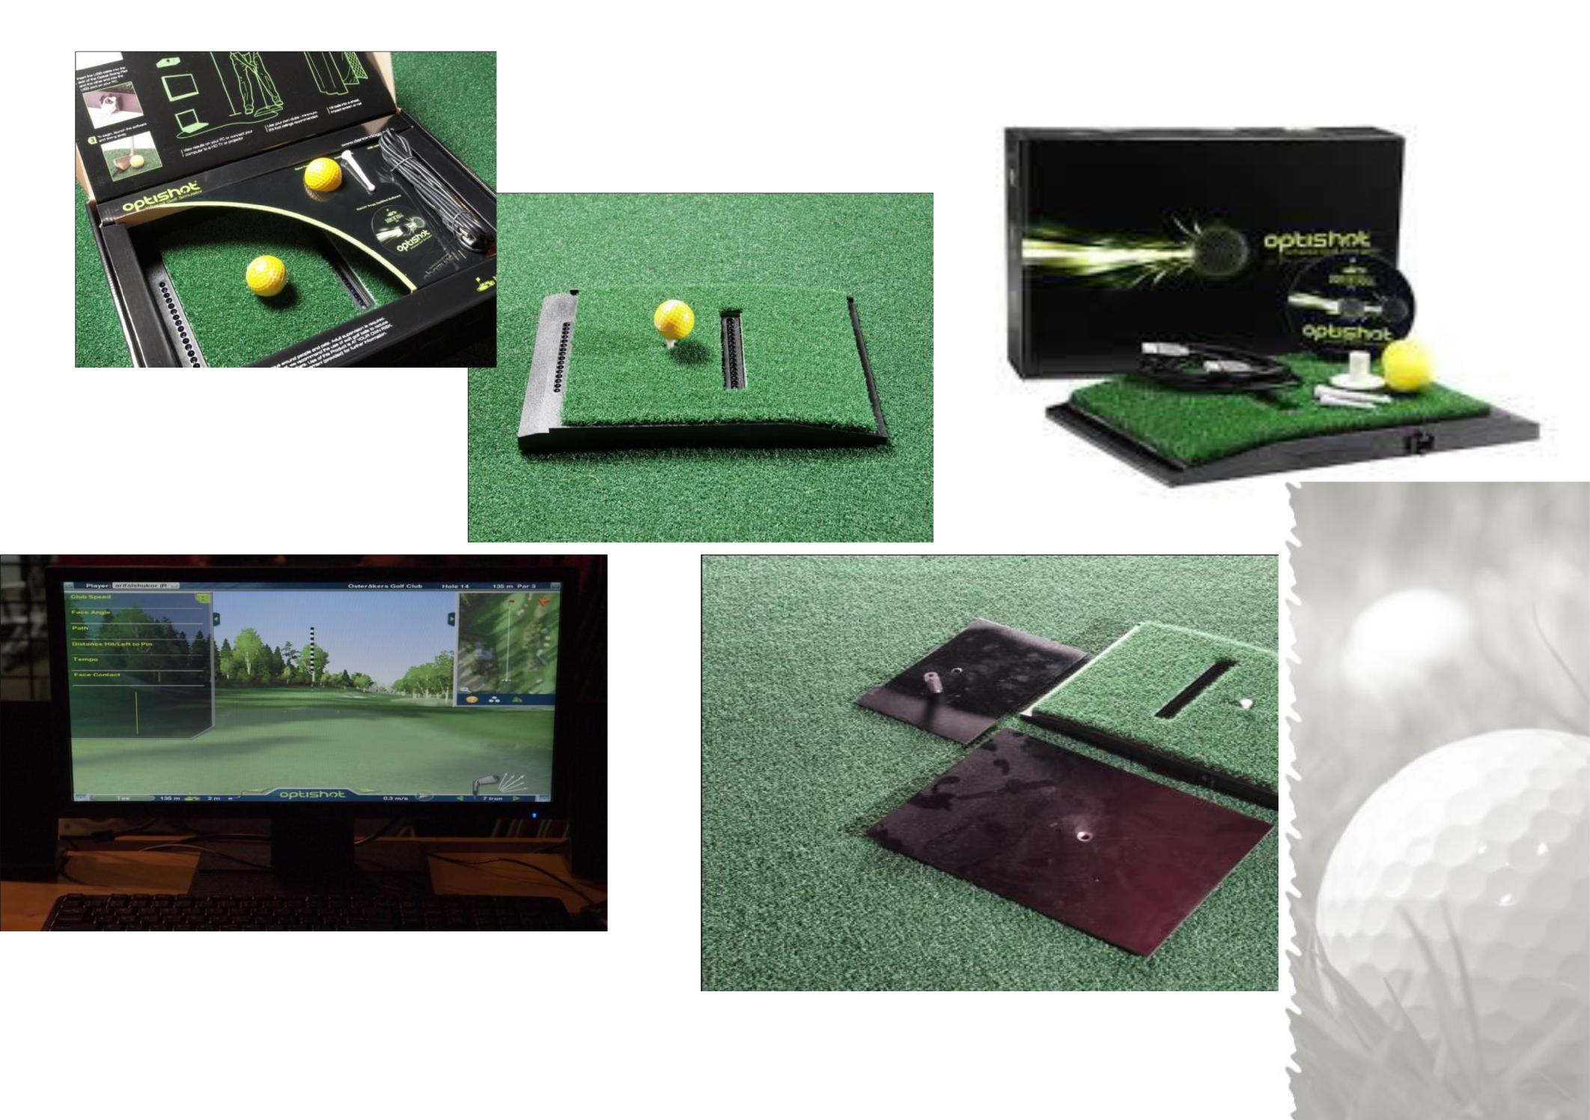
Golf Simulator Item

Slide 18
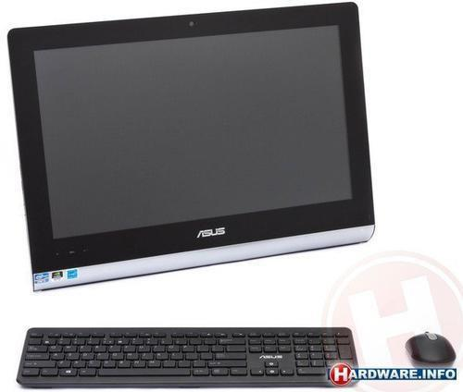
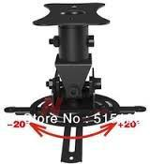
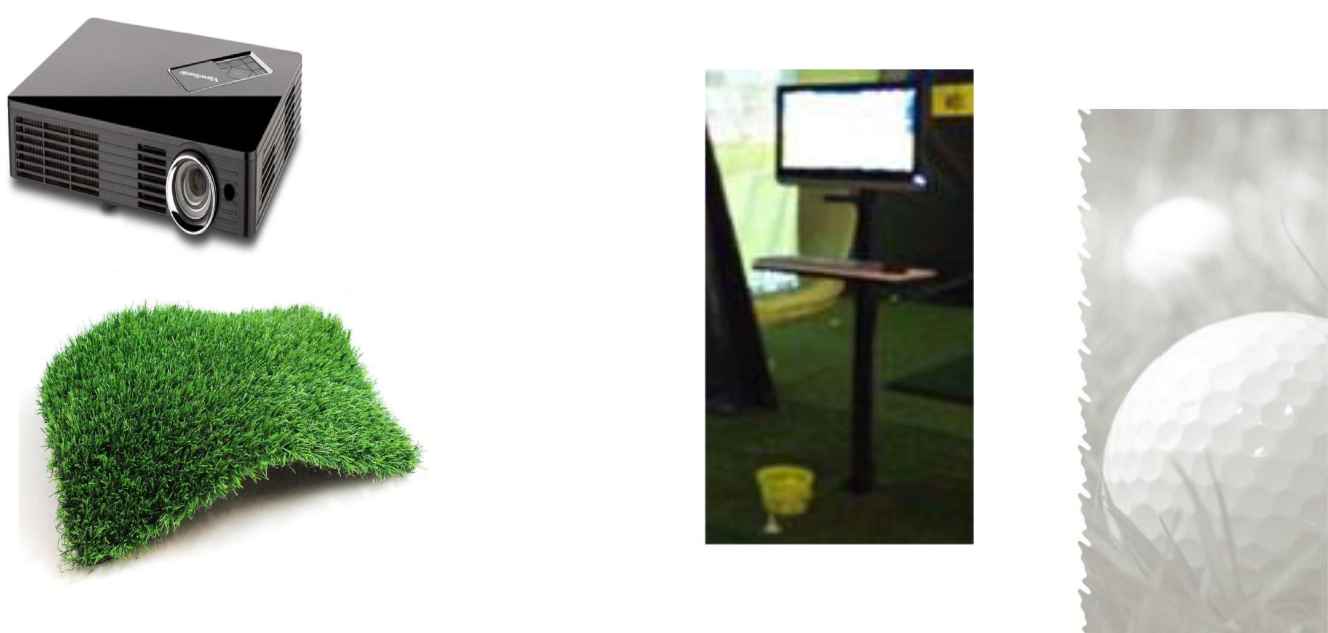
Golf Simulator Item
Projector Mounting
All in one PC
Projector
All in One Pc
Stand
Artificial Grass
6.5’ x 10’
2 pcs

Slide 19
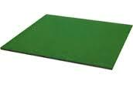
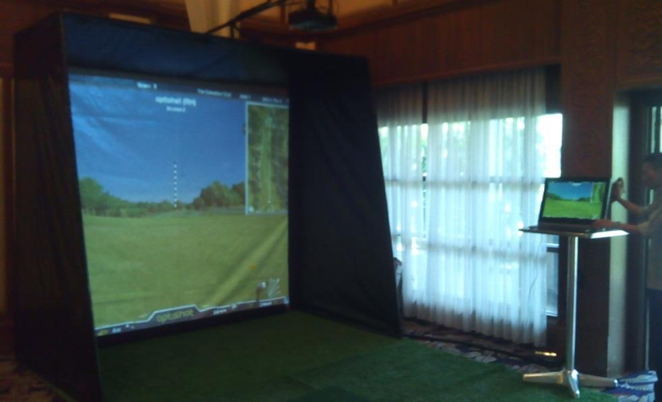
Golf Simulator Item
Golf Mat 5’x5’
Frame Set (8'8"x10'x6')
Canvas Screen White 10’x8’
Canvas Cover Left and Right
Canvas Cover top and Behind

Slide 20
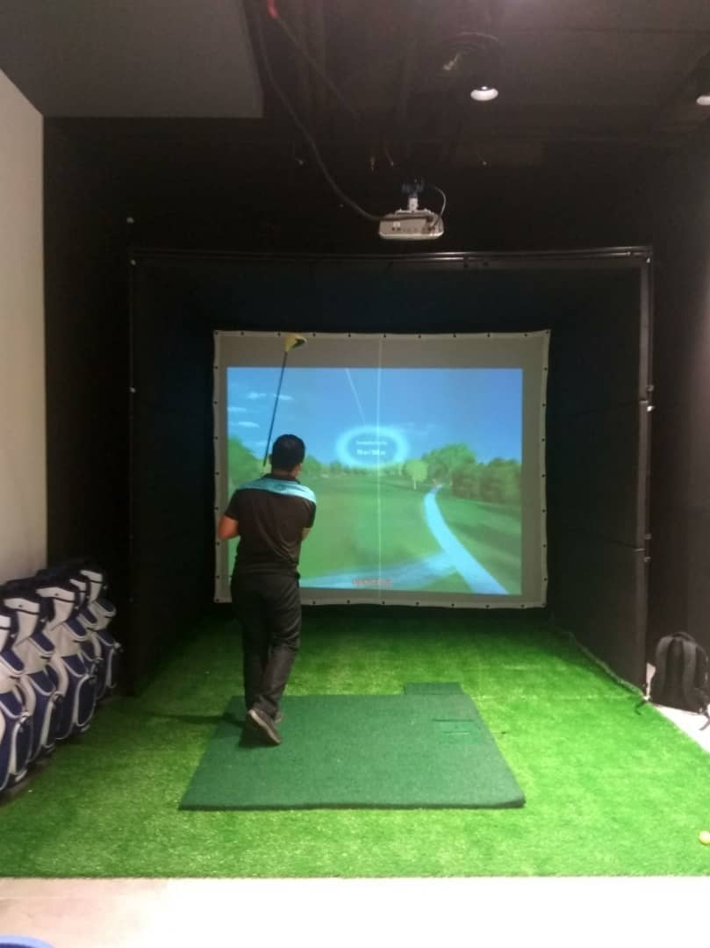
Standard Full Studio Golf Simulator

Slide 21
Standard Full Studio Golf Simulator
Items | Description | Quantity |  | Price | Total
1 | Optishot Simulator (Sensor + Software) (Upgraded) | 1
2 | Golf Mat 5*5 feet | 1
3 | Golf Mat 10*6.5 feet | 2
4 | Desktop PC All in One Touchscreen | 1
 | - Intel i3, 4GB RAM, 1 Tera SATA HD, External Graphic | Card, DVD
 | - 21.5" Screen Monitor
 | - Genuine Windows 8
5 | - PC Stand | 1
6 | Projector | 1
 | - LDP, XGA, 2800 Lumens, Short Throw
7 | - Power Cabel | 1
8 | - Projector Mounting
9 | - HDMI Cable 15' | 1
10 | Frame Set (13"x10'x8') – Can Customize size if small
 | - Steel Frame | 1
11 | - Canvas Screen (White) | 1
12 | - Canvas Cover Black (Left and right, Top and Back) | 1
13 | - Sponge (Left and Right, Top) | 1
14 | Setup and Delivery within Peninsular Malaysia
15 | Technical Support and Service For One Year
 |  |  | Grand Total RM |  | 59,000
Terms & Conditions
Price: Nett in Ringgit Malaysia
Warranty:
- 1 year for Desktop PC and Projector
- 1 year for Optishot Golf Simulator Sensor Upgraded

Slide 22
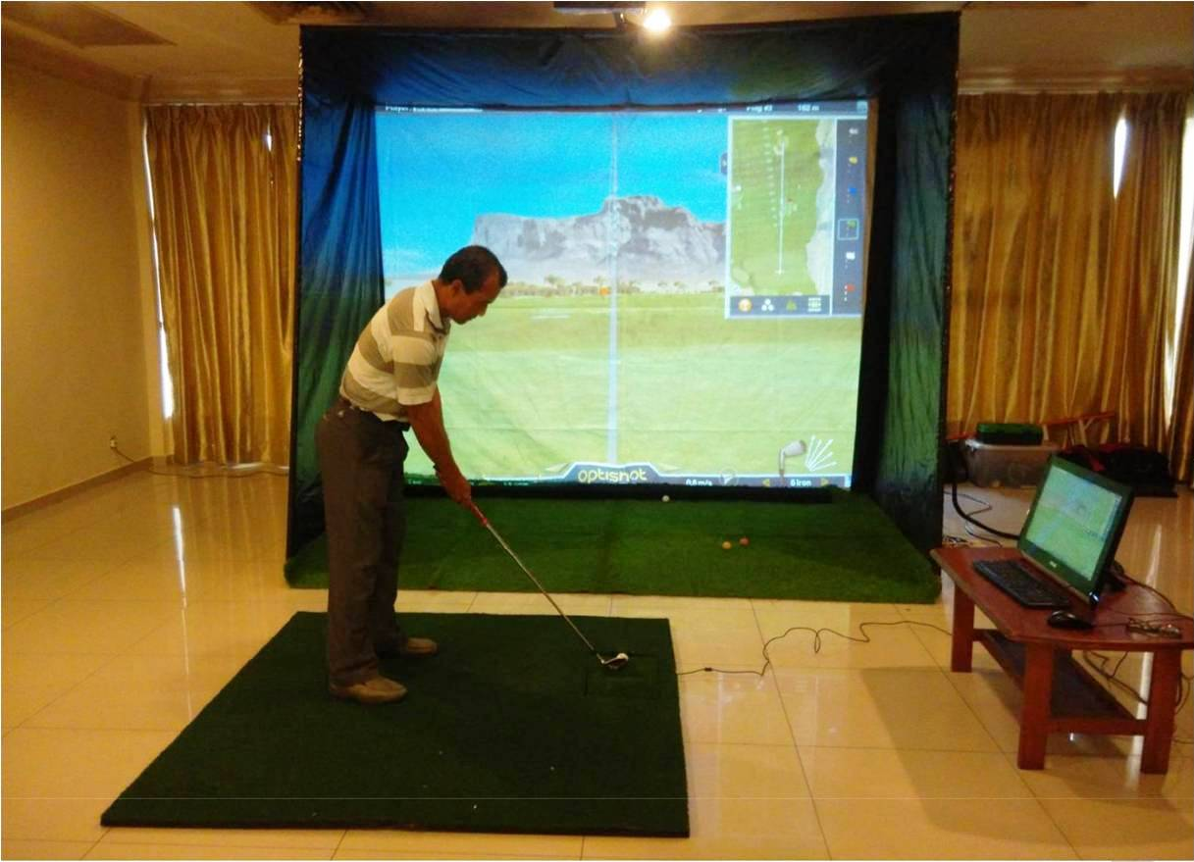
Standard Golf simulator Studio

Slide 23
Standard Studio Golf Simulator
Items | Description | Quantity |  | Price | Total
1 | Optishot Simulator (Sensor + Software) (Upgraded) | 1
2 | Golf Mat 5*5 feet | 1
3 | Golf Mat 10*6.5 feet | 2
4 | Desktop PC All in One | 1
 | - Intel i3, 4GB RAM, 1 Tera SATA HD, External Graphic | Card, DVD
 | - 21.5" Screen Monitor
 | - Genuine Windows 8
5 | - PC Stand | 1
6 | Projector | 1
 | - LDP, XGA, 2800 Lumens, Short Throw
7 | - Power Cabel | 1
8 | - Projector Mounting
9 | - HDMI Cable 15' | 1
10 | Frame Set (8'8"x10'x6')
 | - Steel Frame | 1
11 | - Canvas Screen (White) | 1
12 | - Canvas Cover Black (Left and right, Top and Back) | 1
13 | - Net Front and Back | 1
14 | Setup and Delivery within Peninsular Malaysia
15 | Technical Support and Service For One Year
 |  |  | Grand Total RM |  | 49,000
Terms & Conditions
Price: Nett in Ringgit Malaysia
Warranty:
- 1 year for Desktop PC and Projector
- 1 year for Optishot Golf Simulator Sensor Upgraded

Slide 24
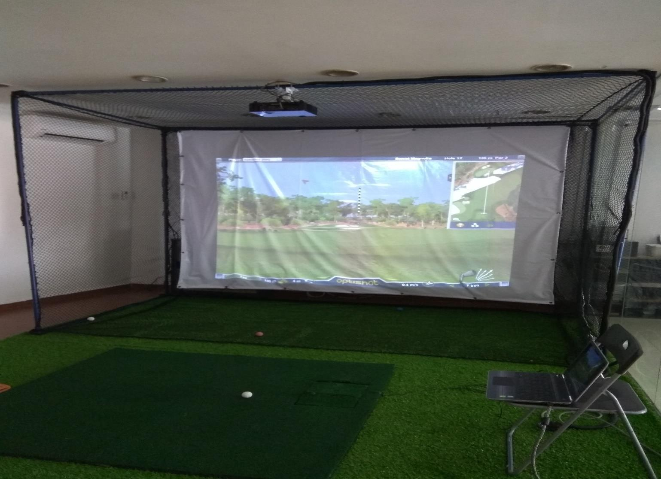
Customized Indoor Golf Simulator Studio Set

Slide 25
Customized Indoor Golf Studio Simulator
Items | Description | Quantity |  | Price | Total
1 | Optishot Simulator (Sensor + Software) (Upgraded) | 1
2 | Golf Mat Artificial Grass 5*5 feet | 1
3 | Golf Mat Artificial Grass 10*6.5 feet | 2
4 | Laptop | 1
 | - Intel i3, 4GB RAM, 1 Tera SATA HD, External Graphic Card, DVD
 | - Genuine Windows 8 - Top Table for Laptop Included
6 | Projector | 1
 | - LDP, XGA, 2800 Lumens, Short Throw
7 | - Power Cabel | 1
8 | - Projector Mounting
9 | - HDMI Cable 15' | 1
10 | Frame Set (9’x10'x6')
 | - IBS Steel Frame | 1
11 | - Canvas Screen (White)- High Impact Fabric Material | 1
12 | - Heavy Duty Net (Left and right, Top, Back and Bottom) | 1
14 | Setup and Delivery within Peninsular Malaysia
15 | Technical Support and Service For One Year
 |  |  | Grand Total RM |  | 39,000
Terms & Conditions
Price: Nett in Ringgit Malaysia
Warranty:
- 1 year for Desktop PC and Projector
- 1 year for Optishot Golf Simulator Sensor Upgraded

Slide 26
Recommended Items purchased additional with Golf Studio Simulator:
Cleveland Golf Mens Package Set RegularFlex
RM2500
Featuring distance driven technology, the new Cleveland Golf Men’s set is specifically engineered to feel lightweight and forgiving for beginner to intermediate players to get the most from their game.
Featuring distance driven technology, the new Cleveland Golf Men’s set is specifically engineered to feel lightweight and forgiving for beginner to intermediate players to get the most from their game.

Slide 27
Recommended Items with extra cost with the Golf Studio Simulator:
Package Includes:
10.5° Driver R Flex with Graphite Shaft with Head Cover
#3 Fairway Wood R Flex with Graphite Shaft with Head Cover
#4 Hybrid R Flex with Graphite Shaft with Head Cover
5-SW Irons R Flex with Graphite Shaft
Putter Steel Shaft with Cover
Cart Bag

Slide 28

Cleveland Mens Full Set for Golf Simulator Perusal

Slide 29
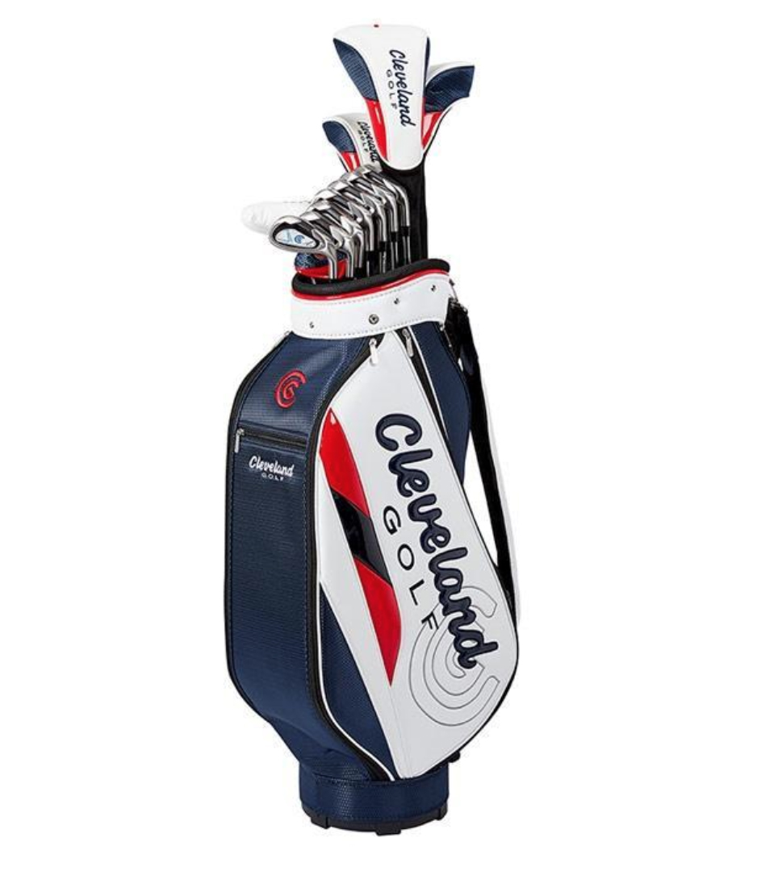
Cleveland Mens Full Set for Golf Simulator Perusal

Slide 30

Golf Ball Srixon SF Tour Special Passion Yellow
RM70

Slide 31
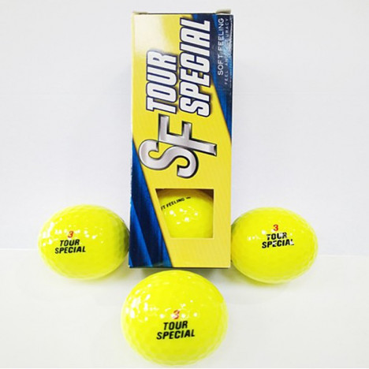
Golf Ball Srixon SF Tour Special Passion Yellow

Slide 32
FAQ
Maintenance for the golf simulator system. How long the response period if the system failure?
1 year / on call and 2 to 3 days for golf simulator repair and services
Completed project reference ?
- Micel Bina Properties, Ipoh, Perak
- Eco Terraces Development Sdn Bhd,
Pulau Pinang
- The Pearl, KLCC, Kuala Lumpur
- Pembinaan Infra E&J,Wisma TTC,
Kuala Lumpur

Slide 33
FAQ
Any basic requirement that need to be provided by developer such data point, plug point etc. ?
Need 3 power point for projector and Pc/laptop
Installation Lead Time Upon Payment Done and TimeLine provided to Proceed:
3 to 4 weeks upon confirmation or projected date / timeframe by Customer
Any software upgrade required and the cost, if any?
Free download online.
Installed ready to play 18 Golf Courses.
Purchase more course online.

Slide 34
FAQ
Terms & Condition?
80% deposit payment required upfront upon release of Customer PO to compile and get ready electronic related gadgets,resources etc in advance.
20% final payment required upon completion of Golf Simulator SetUp and training at the Customer Site and Invoice of Completion Signoff.

Slide 35
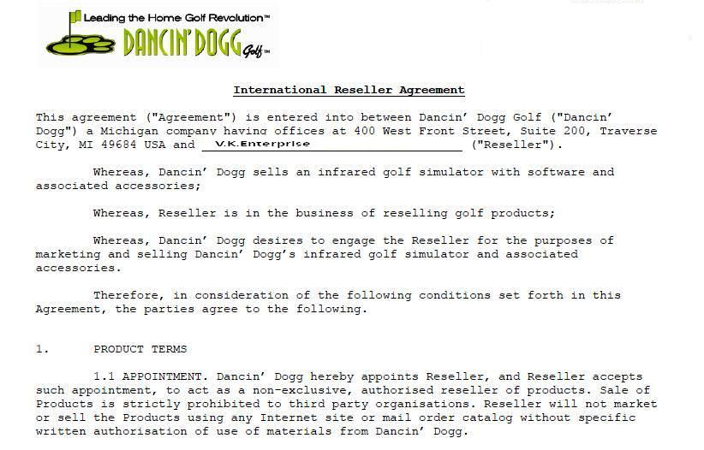

Slide 36
Contact Details
Company Details :
V.K.Enterprise(Golf Specialists)
Lot 1-5,1st Floor,Plaza City One,
Jalan Munshi Abdullah,
50100 Kuala Lumpur.
Tel: 019-3594530
Tel : 016-2926918
Tel : 03-26916612/03-26945992
Email : vkgolfhouse@yahoo.com.my

